Slide 1

Cover Letter Maker App
Automating Personalized Job Applications
Andrew Macdonald
Tech Stack: Java, JavaFX

Slide 2

The Problem
Writing tailored cover letters for each job application is repetitive and time-consuming.
Formatting and personalization are prone to errors, especially under time constraints.
A manual process reduces the number of jobs a candidate can apply to effectively.

Slide 3

The Solution
A JavaFX application that automates cover letter creation.
Parses data from job postings in a specific format.
Substitutes the parsed data into predefined templates with dynamic placeholders.
Generates ready-to-use, personalized cover letters in seconds.

Slide 4
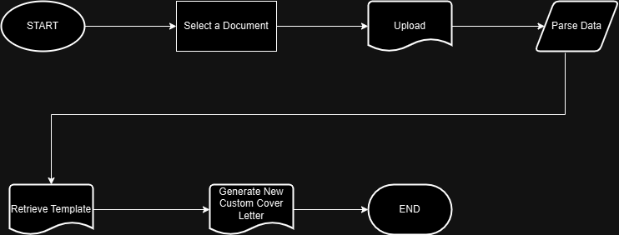
Workflow
Input:
Job posting document (specific format).
Parsing:
Extracts job title, company name, and key skills.
Template:
A predefined letter with placeholders.
Output:
A polished, personalized cover letter.

Slide 5

Features
Document parsing for specific job posting formats.
Dynamic placeholder replacement in templates.
Easy-to-use JavaFX interface.
Rapid generation of cover letters.
Built-in flexibility to adapt to future job site formats.

Slide 6
Challenges and Learnings
Parsing job postings in a consistent format was key but limited initial use to one site.
Learning JavaFX was a challenge as it was a new framework for me.
Gained skills in natural language processing and working with templates dynamically.

Slide 7

Results
Reduced time spent writing cover letters by 80%.
Simplified the application process for job seekers.
Created a flexible and reusable framework for future expansion.

Slide 8

Future Improvements
Support for parsing job postings from multiple formats/sites.
Enhanced NLP to extract more details.
Export options for different formats (PDF, Word).
Cloud-based version for wider accessibility.

Slide 9
THE END
Andrew Macdonald
905-703-5519
amacdonald952@gmail.com

